Slide 1

CSE240
Introduction to Programming Languages
Chapter 4 Functional Language Scheme
Racket Scheme
http://racket-lang.org/

Slide 2
Outline
Introduction
Terminology
Some basic scheme procedures
Define your own procedures -- procedure definition
Scopes: global environment and local names
Programming with data structure
Recursion
Character and string
Symbols, pairs and lists
Modules and their interfaces

Slide 3
Functional versus Imperative Programming
Idea: liberate programming from von Neumann-style imperative languages.
Problems of imperative paradigm:
Imperative paradigm is efficient to implement but, restricts programmer by forcing attention to details: programming is about storing and modifying states.
Often need an understanding of implementation details to understand what a program does.
General problems — complex semantics: referential use of variables and side-effects
Sequential processing

Slide 4
Principles of Functional Programming
Focus on what is wanted rather than how it is implemented.
Higher level of abstraction
Semantics simpler (mathematically defined)
Closer to mathematics --- easier to reason about
No side-effects: referential transparency, no variable
Easier for parallel processing
Functions are treated as first-class objects: function can be placed anywhere, where a value is expected.
Imperative language Functional language
f(x) + f(x) == 2*f(x) ? f(x) + f(x) == 2*f(x)
{ x = GetData(...)
y = ProccessData(x)
PrintResult(y) }
(PrintResult
(ProcessData
(GetData(...))))

Slide 5
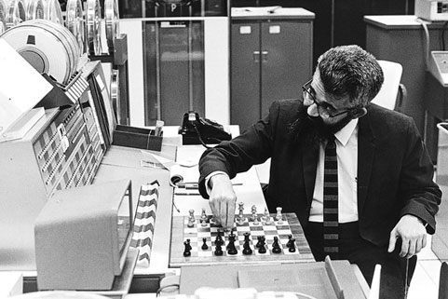
Inventor of LISP
LISt Processing (LISP) was developed in 1950s by John McCarthy
Due to his childhood respiratory problems, he began school a year late, skipped 3 grades and graduated two years early from high school.
In his application to CalTech he wrote a one-sentence statement of purpose: “I intend to be a professor of mathematics.”
He became professors of Princeton University, Dartmouth, MIT, and Stanford.
In 1966, he hosted a series of computer chess matches carried out via telegraph against rivals in Soviet Union.
In 1970s he presented a paper on buying and selling by computer, prophesying what is now called e-commerce.
In 1982 McCarthy originated the idea of the space fountain, a form of "space elevator", a tremendously tall tower extending up from the ground.

Slide 6
A Brief History of LISP and Scheme
Developed specifically for artificial intelligence applications
Inherited from
algebraic syntax of FORTRAN
symbol manipulation of Information Processing Language IPL
mathematics, lambda calculus (λ-calculus), recursion theory
McCarthy's own invention
Common LISP developed in 1980s
a large commercial product, including all possible features
try to be compatible to all existing versions, e.g., Zeta LISP, MacLISP, interLISP
try to merge SCHEME into LISP, but the attempt failed.
Common LISP was standardized by IEEE in 1992.
Industry Movement: Intel Embedded System Group renamed: Intel Intelligent Group.

Slide 7
Scheme: A Dialect of LISP
Developed in 1975 at MIT AI Laboratory as a research and teaching language.
Improvements to LISP include
better scope rule
procedures (functions) as the first-class objects
removing of loops – solely rely on recursive procedure calls to express loops (pure LISP also removed loops)
IEEE Standard in 1989 (Common Lisp in 1992)
Lexical differences, e.g., (zerop x) in LISP versus (zero? x) in Scheme

Slide 8
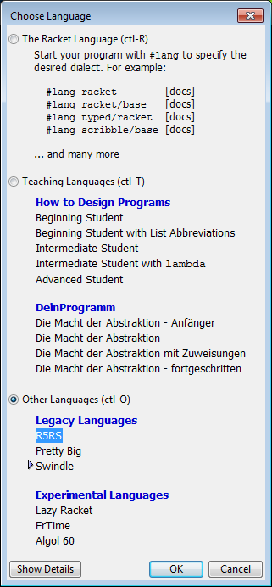
Getting Started
Download: http://racket-lang.org/download/
Start – DrRacket Scheme version 6.11
Choose Language – Default does not work.
You must choose – R5RS, which is a professional edition
Notice that the book is based on R5RS (professional edition). If you choose the Advanced Student version, some features, such as the pair data structure and its operations are not supported

Slide 9
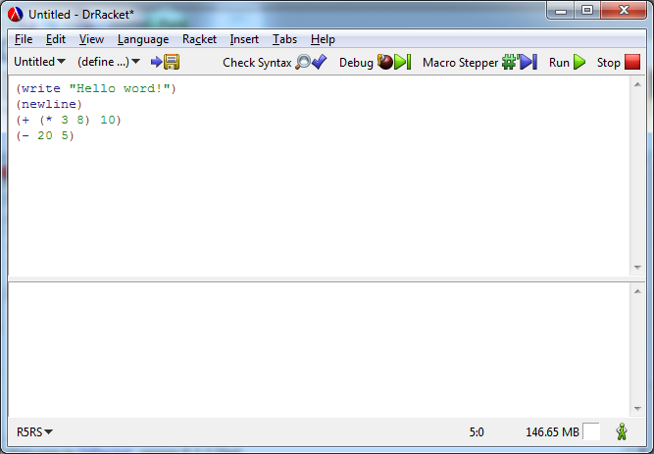

Start Your First Program
After you start the Scheme program, you will have two windows:
(write "Hello word!")
(newline)
(+ (* 3 8) 10)
(- 20 5)
Type the program here
Do not copy and paste code from PPT directly.
Paste into Notepad first to remove the format, and then copy into here.

Slide 10
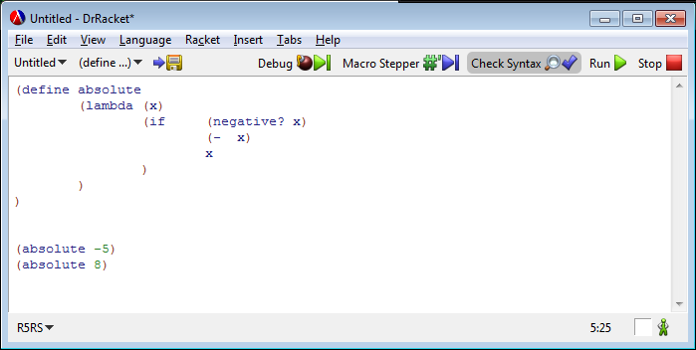

DrRacket Scheme Programming Environment with Debugging Support

Slide 11
Getting Started: Examples
Scheme uses Prefix Notation: Operator before operands.
(quote x) or 'x ; x is a symbol
→ 'x
(symbol? 'James) ; 'James is a symbol
→ true (#t)
(symbol? 5) ; 5 is a number, not a symbol
→ false (#f)
(symbol? '5) → false ; '5 will be evaluated as 5
(symbol? James) ; James is not a symbol
→ false
'(+ 3 1 2 3 7) (+ 3 1 2 3 7)
→ (list '+ 3 1 2 3 7) → 16
'(+ 3 1 2 3 7) is not a symbol. It is a constant list (literal).
(length '(+ 3 x 2 3 7)) (= 35 35) → true
→ 6 (eq? 'James 'James) → true
(length (3 x 2 3 7)) → ? (equal? '(1 5 3) '(1 5 3)) → true

Slide 12
Getting Started: More Examples
(member 2 (quote (1 7 3)))
→ false
(member 2 '(3 1 2 3 7))
→ (2 3 7), which is true.
(member '2 '(1 2 3)) ;'2 is converted to 2
→ true
(= 2 '2) ; '2 is converted to 2
→ true
(member '2 '('1 '2 '3)) ; '2 is not converted in list
→ false
(list '1 '2 '3 '5)
→ (list 1 2 3 5)
(member '2 (list '1 '2 '3 '5))
→ true

Slide 13
Notations of Expressions
Notation of
(x*(a*b + c))
Print the tree in postorder:
xab*c+* {postfix notation}
Print the tree in preorder:
*x+*abc {prefix notation}
Print the tree in inorder:
x*a*b + c {infix notation}
(x*(a*b + c))
Expression Tree

Slide 14
Prefix Notation and Evaluation
infix prefix prefix-p postfix
3 + 4 + 5 + 3 4 5 (+ 3 4 5) 3 4 5 +
3 + 4 * 5 + 3 * 4 5 (+ 3 (* 4 5)) 3 4 5 * +
(3 + 4) * 5 * + 3 4 5 (* (+ 3 4) 5) 3 4 + 5 *
The rules of adding parentheses in the prefix notation
Add an open parenthesis before each operator;
Add a close parenthesis after the last operand of the operation.
Both Scheme and LISP apply these rules!

Slide 15
Basic Data Types
Numbers: include integer and float, e.g., 2, -5, 1.03, 2.5e-3, 3/4
Strings: sequences of characters enclosed in double quotes, e.g., "Hello world!" and "(* 3 5) = 15 is a string"
Symbols: a single quote (apostrophe) followed by a word: 'Jim
Lists: a list of elements of any type: '(3 5 5 Hi Jim (5 9) "Hello")
What are differences between "James" and 'James ?
A string can be processed, but a symbol cannot!
(string-length "James") ⇒ 5
(string-length 'James) ⇒ error, string type expected.
(symbol-length 'James) ⇒ error, function does not exist
(symbol? 'James) ⇒ true (string? 'James) ⇒ false
(symbol? 'Ja mes) ⇒ error (string? "Ja mes") ⇒ true

Slide 16
Terminology
Primitives: The set of predefined operations that Scheme is build on. These operations cannot be defined in terms of anything simpler. For examples
(+ 3 6), (<= 2 5), (sqrt 32), (number? 4.5), (symbol? "x")
Form: Anything you ask Scheme to evaluate is a form. The answer to a form is the value of the form.
(+ 3 6), (+ (* 4 6) 9)
Procedure: a new "primitive" created using define keyword. It returns a value when it is evaluated.
Function: In Scheme, there is no function (function is used in its general meaning only, say, a mathematical function). A procedure in Scheme has the same meaning as the function in C.

Slide 17
Terminology (contd.)
define: It associates (binds) a form to a name. Three parts:
1) The keyword define (define max 100)
2) The name to be defined
3) Any form that gives a value.
define can be used to create a new procedure (operation) that does not exist in the set of primitives.
define-syntax: same as define, but introduce a macro, instead of a procedure. It was called define-macro.
lambda: keyword used to define a procedure.
Argument: The input values that a form needs for performing the evaluation (actual parameter in C).
Parameter: names used when you define a procedure. Parameters will be replaced by arguments when they are evaluated (formal parameter in C).

Slide 18
Terminology (contd.)
Application: Applying an operation to the results of evaluating the other forms, e.g.,
(operation form form ... form) is an application.
The forms are the parameters of the application. According to the definition of forms, an application is a form too. A primitive is not considered as an application
define procedures (parameters, forms)
Scheme
Program
define syntax (parameters, forms)
primitives (operator, values)
forms
(operator, forms)
procedure calls
macro calls
applications

Slide 19
Basic Scheme Procedures
(car list) returns the first element of the list
e.g., (car '(5 3 1 2 3)) → 5
(cdr list) returns the remaining list without the first
e.g., (cdr '(5 3 1 2 3)) → (3 1 2 3)
CAR: Content of Address Register. CDR: Content of Decrement Register in IBM704
(= a b) if a = b, returns true, otherwise, returns false. It applies to numbers. (eq? x y) and (equal? x y)
(list a b c) returns a list (a b c), e.g., (list '(1 2 3) '(5 6)) → ((1 2 3) (5 6))
(append a b) appends b to a e.g., (append '(1 2 3) '(5 6)) → (1 2 3 5 6)
(member a b) if a is an element of list b, returns true, otherwise, returns false.
e.g., (member 5 '(3 7 5 6)) → (5 6), which is considered true.

Slide 20
Basic Scheme Procedures (contd.)
(if c a b) if the value of c is #t, returns a, otherwise, returns b.
e.g., (if (= x 0) (+ a1 a2) (- b1 b2)))
(remainder a b): returns the remainder of a/b
(quotient a b): returns the quotient of a/b
(length L): number of elements in list L, e.g., (length '(2 '5 'a 23.9 "abs" '(2 3))) returns 6
(expt x y): returns the value of x^{y}
(integer? a) or (number? a): returns true if a is an integer or number
(>= a b) or (<= a b)
(null? L) returns true if L is an empty list: '()
Efficiency issues
Which is more efficient: (null? L) or (= (length L) 0) ?

Slide 21
Examples of Nested Operations
x = GetData(...) (PrintResult
x = ProccessData(x) (ProcessData
PrintResult(x) (GetData(...))))
Find the third element in the given list '(3 1 8 9 2)
x = '(3 1 8 9 2)
x = cdr (x)
x = cdr (x)
x = car (x)
(car (cdr (cdr '(3 1 8 9 2))))
(caddr '(3 1 8 9 2))
Find the smallest number in lst = '(3 1 8 9)
(define lst '(3 1 8 9))
(min (min (car lst) (cadr lst)) ; assume (min x y) is defined
(min (caddr lst) (cadddr lst))
)

Slide 22
Order of Evaluation and Parallel Computing
Definition (see text, page 187):
Eager evaluation: Evaluate everything that can be evaluated.
Innermost first;
Evaluate all arguments of a procedure first.
Lazy evaluation: Evaluate only those that are needed.
Outermost first;
Evaluate arguments of a procedure only if their values are needed.
Imperative programming requires of using lazy evaluation only. Functional programs guarantee that the same result will be produced no matter what order is used. It is more friendly for parallel computing
Example 1:
(+ (+ 3 5) (* (+ 4 6) (- 5 3)))
(1) (+ 4 6), (- 5 3), (+ 3 5),
(* 10 2), (+ 8 20)
(2) (+ 3 5), (+ 4 6), (- 5 3),
(* 10 2), (+ 8 20)
Example 2: (if a b c)
a, b, c, if
a, if, b; or a, if, c;
Which is better for parallel computing?
Assuming computing a, b, and c takes one hour each

Slide 23
Define a Procedure (abs)
(1) Define the abs(x) procedure.
(define absolute
(lambda (x)
(if (negative? x)
(- x)
x
)
)
)
(absolute -5) (absolute 8) (absolute 0)
→ 5 → 8 → 0
Shorthand definition
(define (absolute x)
(if (negative? x)
(- x)
x
)
)
Unnamed procedure

Slide 24
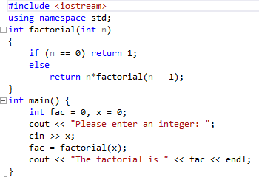
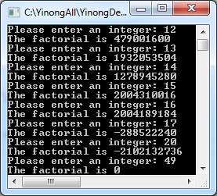
Define a Recursive Procedure in C++
1 if n = 0
n * factorial(n - 1) if n > 0
factorial(n) =

Slide 25
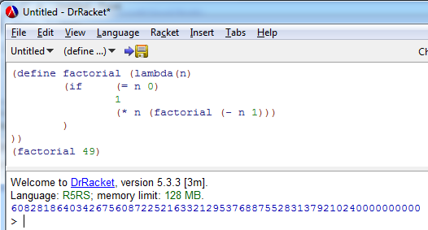
Define a Recursive Procedure in Scheme
1 if n = 0
n * factorial(n - 1) if n > 0
factorial(n) =
(define factorial (lambda (x)
(if (= x 0)
1
(* x (factorial (- x 1)))
)
))
(factorial 49)

Slide 26
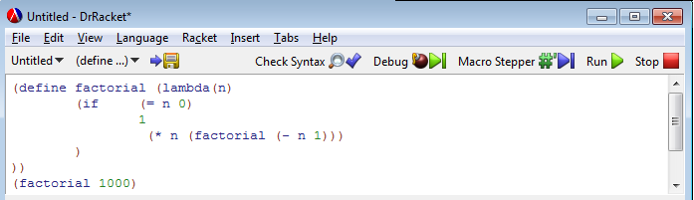
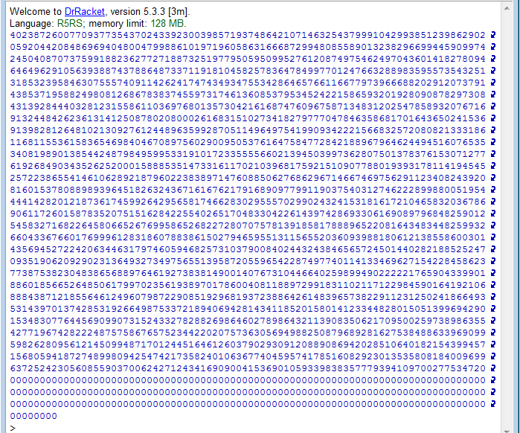
No overflow in Scheme, because math number does not overflow!
A list is used to represent a number.

Slide 27
Define a Procedure (multi-conditional)
(define grades (lambda(n) (cond ((>= n 90) 'A) ((>= n 80) 'B) ((>= n 70) 'C) ((>= n 60) 'D) (else 'E) ; or use (true 'E) )
))
(grades 90) --> A (grades 81) --> B (grades 75) --> C (grades 62) --> D (grades 59) --> E

Slide 28
Case Study ABS (Anti-lock Braking System) and ASR (Acceleration Slip Regulation – Traction Control)
Requirement:
To obtain the maximum braking and traction effect
Algorithm:
Define (or measure) the wheel diameter;
Measure the wheel rotations per seconds rps;
Compute the wheel velocity wv;
Measure the body velocity bv;
Error detection and action:
if (bv > wv), reduce braking force
else if (bv < wv), reduce acceleration force
else "no action"
ABS
Traction control

Slide 29
Implementing an ABS/ASR in C++
in a functional style
#include <iostream>
using namespace std;
const float mile_inch = 63360;
const float mypi = 3.14159;
float wheel_diameter = 15; // inches
float wheel_sensor() {
float rps;
cout << "get rotations per second: " << endl;
cin >> rps; // or from a sensor
return rps;
}

Slide 30
Implementing an ABS/ASR in C++ (contd.)
float wheel_velocity(float rps) {
float wv;
wv = (mypi * wheel_diameter * rps * 3600)/mile_inch;
return wv; // miles
}
float body_velocity() {
float bv;
cout << "get miles per hour: " << endl; // or sensor
cin >> bv;
return bv;
}

Slide 31
Implementing an ABS/ASR in C++ (contd.)
void error_detection(float wv, float bv) {
if (abs(bv - wv) < 0.01)
cout << "no action" << endl;
else
if (bv > wv) // send the signal to actuators
cout << "reduce brake force!" << endl;
else
cout << "reduce acceleration force!" << endl;
}
void start_engine () {
float rps, wv, bv;
rps = wheel_sensor();
wv = wheel_velocity(rps);
bv = body_velocity();
error_detection (wv, bv);
}
void main() {
start_engine();
}
Use variables
Sequentially

Slide 32
Implementing an ABS/ASR in Scheme
(define mile-inch 63360)
(define mypi 3.14159265)
(define wheel-diameter 15) ; inches
(define wheel-sensor (lambda ()
(begin (display "get rotations per second: ")
(read)) ))
(define wheel-velocity (lambda (rps) ; miles per hour
(/ (* mypi wheel-diameter rps 3600)
mile-inch) ))
(define body-velocity (lambda ()
(begin (display "get miles per hour: ")
(read)) ))

Slide 33
Implementing an ABS/ASR in Scheme (contd.)
(define error-detection (lambda(wv bv)
(if (< (abs (- bv wv)) 0.01)
(write "no action")
(if (> bv wv)
(write "reduce brake force!")
(write "reduce acceleration force!"))) ))
(define start-engine (lambda ()
(error-detection (wheel-velocity (wheel-sensor))
(body-velocity) )))
(define main (lambda ()
(start-engine)))
(main) ; call the procedure
Use no variables
No sequential statements

Slide 34
Input / Output and Loop
A form (read) will wait for keyboard input and return the input value.
Example: Compute the average of a set of input numbers.
The number of inputs is unknown;
The program ends when a non-number is entered;
The program displays the average before exiting.
e.g., 3, 2.7, 56, 32, 11.5, 0.6, end
float sum = 0, n = 0, x = 0;
cin >> x;
while (x is a number) {
sum = sum + x;
n++;
cin >> x;
}
if (n>0)
cout << sum/n;
How can we implement the loop in Scheme?
How can we implement the accumulative additions in Scheme?

Slide 35
Input and Output:
sum = 0; n = 0;
loop: sum = sum + input; n++;
average = sum/n
(define average
(lambda () ; no parameter
(accumulator 0 0 (read)))) ; (read) reads anything
(define accumulator ; recursive
(lambda (sum n next)
(if (not (number? next)) ; use of a sentinel
(compute-average sum n)
(accumulator (+ next sum) (+ 1 n) (read)))))
(define compute-average
(lambda (sum n)
(if (> n 0) (/ sum n)
"no number")))
Use parameters as variables!
Every time you pass a different value to the parameter, it has the same effect that you modify a variable!
Use parameters as “variables”:
Every time you pass a different value to the parameter. It has the same effect as you modify variables!
(average) <enter>
78, 92, 70, end
→ 80

Slide 36
Input and Output: Nonfunctional Feature
The output routine is: (display form)
(display (+ 2 3)) → 5
(display "hello world") → hello world
(* (+ 2 5) 4) → 28
(* (display (+ 2 5) ) 4)
ERROR: expects a number as 1st argument, given (void)
What is a math function? f : I → O
In a functional programming language, every procedure should return a value!
A nonfunctional feature detected!
→ ?

Slide 37
begin: Nonfunctional Feature
Unlike other scheme forms, (display form) doesn't return a value!
If you want to display a value of a form and use the result of the form, you can define another form to do so.
(define (myWrite x)
(begin
(display x)
(newline)
x
) )
(* (myWrite (+ 2 5)) 4)
7
28
“begin” starts a sequence of actions, which is imperative!

Slide 38
Print a List as a Number
(define lton (lambda(lst)
(if (null? lst)
"END"
(begin
(write (car lst))
(lton (cdr lst))
)
)
))
(lton '(3 6 4 2)) ; 3642

Slide 39
Environment : Global Names (define)
Environment: A list of names and corresponding values that are valid (known) during and after the execution of a program.
Procedures and names are added to the environment after their definition. They are global. For examples,
(define x 5)
(define average (lambda () ( … ))
(define (myWrite x) ( … ))
If you want to limit the scope of the effect, you have to define the local scope of them by the let form.
name form
x 5
average (lambda
myWrite (…)

Slide 40
Scope: Local Names (let)
Scope of a name: The region of the program in which that name is known.
(let ( (name1 value1)
(name2 value2)
…
(namen valuen))
body)
e.g.,
(let ((a 3) (b 4)) (+ (* a a) (* 2 a b) (* b b)))
The scope of the names is within the body part only.
This is different from imperative languages!

Slide 41
Scope Example 1
Suppose we want to build a space habitat.
We want to calculate the volume of the material needed to build the habitat.

Slide 42
Scope Example 1 (contd.)
(define habitat-material
(lambda (height radius thickness)
(let
( (mypi 3.14159265) )
(let
((cylinder
(lambda (r h)
(* h (* mypi (* r r ))))))
(-
(cylinder radius height)
(cylinder (- radius thickness)
(- height (* 2 thickness)
) ) ) ) ) ) )

Slide 43
Scope Example 1 (contd.)
> (habitat-material 1000 500 5)
→ 23327110.8244125
> mypi
→ Error: unbound name: mypi
> (cylinder 1000 500)
→ Error: unbound name: cylinder

Slide 44
Scope Example 2
(let
( (a 4)
(b (+ a 1)))
(+ a b))
→ 9
? Is it correct?
(let ( (x 9))
(let ( (x 3)
(y (* 5 x)))
(+ x y)))
→ ?
The return value is
18
48
Error
body
body

Slide 45
Example 3: Local Variable and Procedures
(define start-engine (lambda ()
(let (
(wheel-sensor (lambda ()
(begin (display "get rotations per second: ")
(read)) ))
(wheel-velocity (lambda (rps) ; miles per hour
(let ( (mypi 3.1416)
(mile-inch 63360)
(wheel-diameter 15))
(/ (* mypi wheel-diameter rps 3600)
mile-inch) )) )
(body-velocity (lambda ()
(begin (display "get miles per hour: ")
(read)) ))
(error-detection (lambda(wv bv) …
①
②
③
④

Slide 46
Example 3 Local Variable and Functions (contd.)
(error-detection (lambda(wv bv) ; 4th part of let
(if (< (abs (- bv wv)) 0.01)
(write " no action")
(if (> bv wv)
(write " reduce brake force!")
(write "reduce acceleration force!"))) ))
)
; body of start-engine
(error-detection (wheel-velocity (wheel-sensor))
(body-velocity) ))))
(define main (lambda ()
(start-engine)))
(main)
④

Slide 47
Unnamed Procedures
f(x) = x²
f(5) = 25
f(x) = x³
(f(x), 5) = 125
((lambda (x y) (+ ( * x x) (* y y))) 3 4 )
→ 25
((lambda (x y) (+ ( * x x) (* y y))) 5 10 )
→ 125
((lambda (x y) (+ ( * x x) (* y y)))
3 ; argument for x
((lambda (z) (+ z 3)) 4) ; argument for y
)
→ 58

Slide 48
Converting between let-form & Unnamed Procedure
Let-forms and unnamed procedures are equivalent: they can be converted from one to the other.
(let
( (name1 value1)
(name2 value2)
. . .
(namen valuen)
)
body
)
It can be translated into an unnamed procedure:
((lambda (name1 name2 . . . namen)
body)
value1 value2 ... valuen)

Slide 49
Examples Converting let-form & Procedure
(let ((x 9))
(let ((x 3)
(y (* 5 x)))
(+ x y))
)
((lambda (x)
((lambda (x y)
(+ x y) )
3 (* 5 x)))
9
) ; → 48
(let
( (a 4)
(b (+ a 1)))
(+ a b)
)
((lambda (a b)
(+ a b)) 4 (+ a 1))
→ ?
Obviously,
a in (+ a 1) is unbound.
If you change let to let*,
it works then.

Slide 50
Application of let in Database Query Language LINQ: Language Integrated Query
from car in root.Elements("car")
let profiles =
from profile in car.Elements("profile")
select new {
Name = profile.Attribute("name").Value,
Value = profile.Attribute("value").Value
}
let supports =
from support in car.Elements("support")
select new {
Name = support.Attribute("name").Value,
Value = support.Attribute("value").Value
}
select new Car {
Name = car.Attribute("name").Value,
Vendor = profiles.Single(prof => prof.Name == "Vendor").Value,
Model = profiles.Single(prof => prof.Name == "Model").Value,
Doors = int.Parse(profiles.Single(prof => prof.Name == "Doors").Value),
RacingSupport = supports.Single(sup => sup.Name == "Racing").Value == "yes"
};
Lambda expression

Slide 51
The Fantastic Four of Writing Recursive Functions
(The Simple Four-Step Abstract Approach)
Formulate the size-n problem.
Find the stopping condition and the corresponding return value.
Formulate the size-m problem and find m. In many cases, m = n - 1;
Construct the solution of size-n problem from size-m problem.

Slide 52
Hanoi Towers: Following the Design Steps
Step 1 Size-n problem
(hanoi n source center destination)
Step 2
Stopping condition
(size-1 problem):
Move disk from source to destination
Step 3:
Size-(n-1) problem
Several cases:
(hanoi n-1 source center destination)
(hanoi n-1 center source destination)

Slide 53
Hanoi Towers Example:
Step 4: Construct the solution of size-n problem
Initial state:
(1):
Move n-1 disks
to the center peg
(2):
Move 1 disk
to the right peg
(3):
Move n-1 disks
to the right peg

Slide 54
Hanoi Towers Program
(define hanoi (lambda (n source center destination)
(if (= n 1) ; stopping condition
(begin
(display "move top from ")
(display source)
(display " to ")
(display destination)
(newline)
)
(begin ; from size-(n-1) to size-n problem
(hanoi (- n 1) source destination center)
(hanoi 1 source center destination)
(hanoi (- n 1) center source destination)
)
)
))

Slide 55
Hanoi Towers Program Output
(hanoi 3 "Left" "Center" "Right")
move top from Left to Right
move top from Left to Center
move top from Right to Center
move top from Left to Right
move top from Center to Left
move top from Center to Right
move top from Left to Right

Slide 56
Scheme Procedure Finding the GCD
int gcd(int n, int m) // C program
{
if (n == 0) return m;
else if (n <= m) return gcd(n, m-n);
else return gcd (m, n);
}
Size-n problem
(define gcd (lambda (n m)
(if (= n 0)
m
(if (<= n m)
(gcd n (- m n))
(gcd m n)
))))
Stopping condition
Return value
Stopping condition
Return value
Construction size-n solution from size-m definition
Size-m problems
Size-m problems
(gcd 3 9) → 3

Slide 57
Programming with Data Structures
We have dealt with some of the data structures, and will learn more.
boolean
Number: You can check if a number is
integer, real, rational, positive, nonnegative, etc.
character
string
pair
symbol
list
procedure

Slide 58
Number Conversion
(define dtob (lambda (N)
(if (= N 0)
(list '0)
(append (dtob (quotient N 2))
(list (remainder N 2)))
)) )
(dtob 19)
→ (0 1 0 0 1 1)
What does the following program do?
(define dtod (lambda (N)
(if (= N 0)
(list '0)
(append (dtod (quotient N 10))
(list (remainder N 10)))
)) )
(dtod 248)
→ ?

Slide 59
Addition of Binary Numbers
Define a procedure to add two binary numbers in list form.
10110
+ 11110111
1 1 1 1 1 1
(define binaryadd (lambda(L1 L2)
(let ((len1 (length L1)) (len2 (length L2)))
(if (> len1 len2)
(binaryadd L2 L1)
(if (< len1 len2)
(binaryadd (append '(0) L1) L2)
(recursiveAdd (append '(0) L1) (append '(0) L2) 0)
)) ) ))
100001101
000010110
+ 011110111
1 1 1 1 1 1
100001101
Carry in

Slide 60
Addition of Binary Numbers (contd.)
(define recursiveAdd (lambda(L1 L2 carry)
(if (null? L1)
'()
(let ((t (+ (tail L1) (tail L2) carry)))
(append (recursiveAdd (rmtail L1)
(rmtail L2)
(quotient t 2))
(list (remainder t 2))
)) ) ) )
(define (tail L) ; returns the last element of L
body )
(define (rmtail L) ; returns list without last element
body )
000010110
+ 011110111
1 1 1 1 1 1
100001101

Slide 61
Data Types: Character Type
To differentiate a character type from other types, e.g., number, symbol, or string, we use #\5 for character 5, #\A for capital character A, and #\b for little b.
To check if a name is a character:
(char? 5) → false (number? 5) → true
(char? #\5) → true (number? #\5) → false
(+ 5 7) → 12 (+ #\5 #\7) → ERR
(char? true) → false (number? true) → false
(boolean? #t) → true (boolean? #f) → true
(char=? #\A #\a) → false (char=? #\A #\B) → false
(char-ci=? #\A #\a) → true (char-ci=? #\A #\B) → false
(char-alphabetic? #\d) →true (char-alphabetic? #\4) → false

Slide 62
Data Types: Character Operations
Example: Define a procedure to detect a vowel.
(define vowel?
(lambda ()
(begin
(display "Please enter a character")
(newline)
(let ((ch (read)))
(if (or
(char-ci=? ch #\A)
(char-ci=? ch #\E)
(char-ci=? ch #\i)
(char-ci=? ch #\o)
(char-ci=? ch #\u)
)
(display "Yes, it is a vowel")
(display "No, it is not a vowel")
) ) ) ) )
(vowel?) #\w --> No, it is not a vowel

Slide 63
ASCII (American Standard Code for Information Interchange)
Full table at the end of the text
Binary representation
Decimal
Character(s)
000 0000
-
001 1111
0
-
31
control codes, e.g.
carriage return, line
feed, other teletype
functions.
010 0000
32
the blank character
(space)
010 0001
-
010 1111
33
-
47
special characters
(e.g. !, *, +,
-
)
011 0000
-
011 1001
48
-
57
digits 0 - 9
011 1010
-
100 0000
58
-
64
special characters
100 0001
-
101 1010
65
-
90
capital A - Z
101 1011
-
110 0000
91
-
96
special characters
110 0001
-
111 1010
97
-
122
lower case a - z
111 1011
-
111 1111
123
-
127
special characters

Slide 64
Data Types: Character Operations
(char->integer #\A) → 65 (integer->char 97) → #\a
(char->integer #\C) → 67 (integer->char 36) → #\$
(char->integer #\5) → 53 (integer->char 57) → #\9
Based on the numeric codes of characters, we can do such comparisons as:
(char<? #\A #\a) → true (char>? #\9 #\d) → false

Slide 65
Data Types: Strings and Operations
A string is a sequence of characters in the quotation mark.
(string? 55) → false (string? "55") → true
(string? #\5) → false (string? "#\5") → true
(string-length "United States of America") → 24
(string-length "") → 0
(string-append "United States" "of America")
→ United Statesof America
(string-length "United States of America") → 24
(string-ref "United States" 5) → #\d
(string-ref "United States" 6) → #\space
(substring "PICKLE" 1 4) --> ICKL

Slide 66
Data Types: Cipher Encryption Example
(define string-encryption ; umbrella procedure
(lambda (str)
(encryption-recursive str 0 (string-length str))
) )
(define encryption-recursive
(lambda (str pos len)
…
))
Size-n Problem

Slide 67
Encrypt a string: Cipher Encryption Example

Size-n: (encryption-recursive str pos len)
str:
h
e
l
l
o
w
o
r
l
d
pos = 0

Stopping:
h
e
l
l
o
w
o
r
l
d
pos = len
●
Size-(n-1):
h
e
l
l
o
w
o
r
l
d
pos = 1
❍
From
n-1 to n
(string-append
(character-encryption (string-ref str pos))
(encryption-recursive str (add1 pos) len)
)

Slide 68
Data Types: Cipher Encryption Example
(define string-encryption ; umbrella procedure
(lambda (str)
(encryption-recursive str 0 (string-length str))
) )
(define encryption-recursive (lambda (str pos len)
(if (>= pos len)
"" ; empty string
(string-append
(character-encryption (string-ref str pos))
(encryption-recursive str (add1 pos) len)
) ) ) )

Slide 69
Data Types: Cipher Example (contd.)
(define character-encryption
(lambda (ch)
(if (char-alphabetic? ch)
(string (character-rotation ch))
(string ch) ; non-letter will not be encrypted.
) ) )
(define character-rotation
(lambda (ch)
(integer->char (+ (char->integer ch) 3) ; key=3
) ) )
(string-encryption "in case 3")
→ "lq fdvh 3"

Slide 70
Data Types: Pairs and Structures
The fundamental structured data type in Scheme is the pair: a pair of elements: (x . y)
The following operations can be applied to a pair:
Constructor: (cons a b) makes a new pair (a . b)
Accessors: (car pair) returns the 1st value of the pair.
(cdr pair) returns the 2nd value of the pair.
Predicate: (pair? x) returns true if x is a pair, false otherwise.
Example:
(let ( (a (cons 1 2)) ; (1 . 2)
(b (cons 4 8))) ; (4 . 8)
(+ (car a) (cdr b))) ; = 9
⇒ 9

Slide 71
Pair Notations: Dot & Box Notations
(cons 1 2) = (1 . 2)
(cons 1 (cons 2 3) = (1 . (2 . 3)) ⇒ (1 2 . 3)
(1 . (2 . (3 . 4))) ⇒ (1 2 3 . 4)
Rule 1 for simplification:
Omit the dot and the parentheses when the item to the right of the dot is a pair. Printing of pairs follows this rule.
(display '(((1 . 2) . (7 . 9)) . (3 . (4 . 5))))
⇒ (((1 . 2) 7 . 9) 3 4 . 5)
Box notation: (2 . 5) =
(2 . (2 . 3)) =
((1 . 2) . (3 . (4 . 5))) = ?
2
5
2
2
3

Slide 72
Pairs: Box & Arrow (Tree) Notations
'(1 . (2 . 3)) =
'(1 2 . 3)
'((1 . 2) . (3 . (4 . 5))) =
'((1 . 2) 3 4 . 5)
'(((1 . 2) . (7 . 9)) . (3 . (4 . 5))) =
'(((1 . 2) 7 . 9) 3 4 . 5)
3
4
5
7
9
1
2

Slide 73
Direct Applications of Pairs
Pairs are useful for data in pairs, i.e.,
The position of a city can be represented in a pair (latitude . longitude).
List of pairs can form a database, e.g., list of items consisting of (city-name . (latitude . longitude))
Collections of data can be built from pairs — lists are special cases of nested pairs (later).

Slide 74
Quotes and Symbols
We know how to construct, access, represent, and display structured data (pairs).
How do we enter a structured data like (1 . 2)?
(1 . 2) <enter>
*** ERROR IN [compilation] -- Ill-formed procedure application --- Why?
In Scheme:
Everything in parentheses is an application that will be evaluated.
Anything started with an apostrophe mark will not be evaluated.
'(1 . 2) <enter> '((1 . 2) . (3 . (4 . 5))) <enter>
⇒ (1 . 2) ⇒ ((1 . 2) 3 4 . 5)

Slide 75
Use of Quotes (Apostrophes)
What can or must be quoted?
You must quote pairs and lists,
You must not quote sub-lists (lists in a list quoted already) or anything in a list.
You must not quote forms that you want to evaluate
You may quote numbers, strings and booleans, but it makes no difference -- don't quote them.
Exercises: Try following forms.
(+ 2 '2) ('+ 2 3) '(+ 2 3)
(define a a) (define a 'a) (define a '(1 2 3 .4)
(1 . 2) '(1 2 . 3) (1 . (2 . (4 . 5)))
(member 'jim '(3 5 5 Hi 'jim (5 9) "Hello")) → false
(member ''jim '(3 5 5 Hi 'jim (5 9) "Hello")) → true
2 's

Slide 76
Symbols
Operations can be applied to symbols:
Constructors: (quote x) or ‘x
string->symbol, e.g., (string->symbol "Jim")
Accessors: symbol->string, e.g., (symbol ->string 'Jim)
Predicates: (symbol? x) returns true if x is a symbol, false otherwise.
(eq? x y) returns true if x & y are equal.

Slide 77
Lists
Definition of List :
<list> ::= '( )
<list> ::= (cons x <list>), where x can be any Scheme form.
constructor of pair
In words, if a is a list, (cons x a) creates a new list whose first element is the value of x and whose remaining elements are those found in a.
Are all lists pairs? ; (pair? '()) --> ?
(cons 4 '( )) ⇒ (4 . ( )) ⇒ (4) ; Rule 2 for simplification
(cons 7 '(4)) ⇒ (7 . (4)) ⇒ (7 4)
(cons 7 (cons 4 '( ))) ⇒ (7 4) (cons 7 4) ⇒ (7 . 4)
(cons 9.2 '(7 4)) ⇒ (9.2 7 4) (cons 9.2 '(7 . 4)) ⇒ (9.2 7 . 4)
Rule 2 for simplification:
Omit the dot and the parentheses representing empty list.

Slide 78
Operations on Lists
Constructors: (cons x a)
(list item1 item2 ... itemn)
e.g., (list 2 '(1 2) 3 7) ⇒ (2 (1 2) 3 7)
(append list1 list2)
e.g., (append '(1 2 3) '(2 1 5)) ⇒ (1 2 3 2 1 5)
Accessors: (car any-list) ; except empty list
(cdr any-list) ; except empty list
(length any-list)
(list-ref any-list pos)
e.g., (list-ref '(1 3 8 5 7) 1) ⇒ 3
(list-tail any-list pos)
e.g., (list-tail '(1 3 8 5 7) 2) ⇒ (8 5 7)
Predicates: (list? x) returns true if x is a list, false otherwise.

Slide 79
Relationships between Pairs and Lists
(list? '(1 2)) ⇒ true (list? '(1 2 3 4 5)) ⇒ true
(list? '(1 . 2)) ⇒ false (list? '(1 2 3 4 . 5)) ⇒ false
(car '(1 2 3 4 5)) ⇒ 1 (cdr '(1 2 3 4 5)) ⇒ (2 3 4 5)
(car '(1 2 3 4 . 5)) ⇒ 1 (cdr '(1 2 3 4 . 5)) ⇒ (2 3 4 . 5)
What is the relationship?
They are both constructed by (cons a b)
Some operations produce the same results
Some operations produce different results
Are list-type and pair-type equivalent? ⇒ No
Is pair-type a subtype of list-type ⇒ ? (list? '(1 . 2))
Is list-type a subtype of pair-type ⇒ ? (pair? '(1 2))

Slide 80
Lists Are Pairs, Except ...
Let us check more operations:
(pair? '(1 2 3 4 5)) ⇒ ?
(cons 1 (cons 2 (cons 3 (cons 4 (cons 5 '())))))
⇒ (1 . (2 . (3 . (4 . (5 . ())))))
⇒ (1 2 3 4 5 . ())
⇒ (1 2 3 4 5) ; the last '() is omitted
(pair? '(1 2 3 4 5 . ())) ⇒ true
(pair? '(1 2 3 4 5)) ⇒ true
Is list-type a subtype of pair-type? ⇒ yes, except '()
List is a special case of pairs, of which the last element is a '( ). However, (pair? '()) --> false.

Slide 81
Manipulation of Lists
Example: Sum of list elements.
(define sum-list (lambda (L)
(if (null? L)
"The list is empty and has no sum"
(sum-nonempty-list L)
)
))
(define sum-nonempty-list (lambda (L)
(if (null? L)
0
(+ (car L) (sum-nonempty-list (cdr L))))
))
(sum-list '()) ⇒ "The list is empty and has no sum"
(sum-list '(2 4 6 8)) ⇒ 20
Size-(n-1) problem

Slide 82
Manipulation of Lists
Example: Reverse a list.
(define reverse-list (lambda (lst)
(if (null? lst)
'()
(append (reverse-list (cdr lst)) (list (car lst)))
)
))
(reverse-list '(1 3 5 7 9)) ⇒ (9 7 5 3 1)
Size-(n-1) problem

Slide 83
Higher-Order Functions
Parameter passing by name
Call-by-name
Definition
A higher-order function is a function that takes another procedure name as an argument
Functional programming languages support higher-order function.
Mapping: apply the same procedure/operation to all elements of a list.
Reduction: take many elements of a list and compute one result.
Filtering, remove elements that do not satisfy a predicate (procedure).
Procedures with a variable number of parameters

Slide 84
Mapping
(map proc a-list) will apply the procedure proc to all elements of a-list.
Example
(define foo (lambda (x) ( ... )))
(map foo '(3 6 9 12 15 18))
(define square (lambda (x) (* x x)))
(map square '(3 6 9 12 15 18))
⇒ (9 36 81 144 225 324)
(define foo (lambda (x) (+ (* x x ) x))
(map foo '(3 6 9 12 15 18)) ; foo(x) = x² + x
⇒ (12 42 90 156 240 342)

Slide 85
Mapping Example: One's Complement
(define onescomplement (lambda (a-list)
(if (null? a-list)
'()
(if (= (car a-list) 0)
(cons 1 (onescomplement (cdr a-list)))
(cons 0 (onescomplement (cdr a-list)))))))
(onescomplement '(0 1 1 1 0))
⇒ (1 0 0 0 1)
(define not-gate (lambda(x) (if (= x 0) 1 0)))
(define onescomplement (lambda (a-list)
(map not-gate a-list)))

Slide 86
Two’s Complement
(define twoscomplement (lambda(x)
(binaryadd (onescomplement x) '(1))
))
(onescomplement '(0 1 1 1 0 0))
(twoscomplement '(0 1 1 1 0 0))
(1 0 0 0 1 1)
(1 0 0 1 0 0)
What is the output of the following call?
(onescomplement '(0 1 2 3))
(1 0 0 0), (1 0 1 1), or Error message?

Slide 87
Mapping Example: String-Encryption
(define string-encryption
(lambda (str)
(encryption-recursive str 0 (string-length str))))
(define encryption-recursive
(lambda (str pos len)
(if (>= pos len)
""
(string-append
(character-encryption (string-ref str pos))
(encryption-recursive str (add1 pos) len))))
(define string-encryption
(lambda (str)
(list->string (map character-encryption
(string->list str)))))

Slide 88
character-encryption
(define character-encryption
(lambda (ch)
(if (char-alphabetic? ch)
(character-rotation ch)
ch ; non-letter will not be encrypted.
) ) )
(define character-rotation
(lambda (ch)
(integer->char (+ (char->integer ch) 3) ; key=3
) ) )

Slide 89
Map: How is it Implemented?
(define map1
(lambda (proc a-list)
(if (null? a-list)
'()
(cons (proc (car a-list))
(map1 proc (cdr a-list)))
)
)
)
Size-(n-1) problem
Can I use append here?
Yes!, but cons is simpler than append here
The map function can only be used to a plain list.
(map square '((3 6) 9 12 15 18))
--> ERROR -- NUMBER expected

Slide 90
Deep-Mapping
(define deep-map (lambda (proc a-list)
(if (null? a-list)
'()
(if (pair? a-list)
(cons (deep-map proc (car a-list))
(deep-map proc (cdr a-list)))
(proc a-list)
)
)
) )
(define time3 (lambda (x) (* x 3)))
(deep-map time3 '(2 (3 (4 5)) 9 12 15 18))
⇒ (6 (9 (12 15)) 27 36 45 54)

Slide 91
Reduce
Map allows us to apply the same operation to many data simultaneously,
Reduce allows us to combine the multiple results from the map into a single result.
(sum-list '(12 33 564 122 12 1 4))
(define sum-list (lambda (x)
(if null? x)
0
(+ (car x) (sum-list (cdr))))))

Slide 92
Reduce: More Examples
(product-list '(12 33 564 122 12 1 4))
(average-list '(12 33 564 122 12 1 4))
(max-list '(12 33 564 122 12 1 4))
(min-list '(12 33 564 122 12 1 4))
Reduce function provides a generic way of handling all these functions.
Like other higher-order functions mapping and filtering, the idea is to apply a reduce function to another function, e.g.
(reduce add a-list)
(reduce multiply a-list)

Slide 93
Implementation of Reduce
Using parameter passing by name, we can pass the operator “+” as a parameter to reduce, and reduce applies the operator to all the data.
We need to have the parameter base, because different functions need different bases. E.g., sum need 0 and product needs 1 as base.
(define reduce
(lambda (op base x) ;passing by name
(if (null? x)
base
(op (car x) (reduce op base (cdr x)) )))
)
Stopping condition value
Size-(n-1) problem

Slide 94
Application of Reduce
Once the reduce higher-order function is defined.
Sum:
(reduce + 0 '(2 4 6 8 10)) ⇒ 30
Product:
(reduce * 1 '(2 4 6 8 10)) ⇒ 3840
Average:
(/ (reduce + 0 '(2 4 6 8 10))
(length '(2 4 6 8 10)))
⇒ 5

Slide 95
Parallel Computing by Map and Reduce
Industry Application:
Google Search Engine Using MapReduce
Solution 1
Solution 2
Map
Solution 3
Reduce
A large problem
Final Solution
MapReduce comes from the high-order function concept!
Solution n

Slide 96
Filtering
A filter is similar to mapping and reduce. It applies a procedure to all members of a list.
(filter proc a-list)
The difference is that the procedure proc here is a predicate. The elements that do not meet the predicate proc will be removed (filtered out) from the list.

Slide 97
Filtering
(filter (lambda (x) (> x 200)) '(50 300 500 65 800))
⇒ (300 500 800)
(define big-class? (lambda (x) (>= (cdr x) 80)))
(define class-size
'(("CSE100" . 100) ("CSE200" . 80) ("CSE240" . 100) ("CSE310" . 70) ("CSE340" . 75) ("CSE420" . 65)))
(filter big-class? class-size)
⇒ '(("CSE100" . 100) ("CSE200" . 80) ("CSE240" . 100))

Slide 98
Filtering: How is it implemented?
(define filter (lambda (pred a-list)
(if (null? a-list)
'()
(if (pred (car a-list))
(cons (car a-list) (filter pred (cdr a-list)))
(filter pred (cdr a-list))))))
Size-(n-1) problem
including is
done here
excluding (filtering)
is done here

Slide 99
SQL as a Functional Programming Language
Create an array of Book object, to be used for queries.
class program {
static void Main() {
Book[ ] Books = new Book[ ] {
new Book {bookid = 1, title = "Programming",
isbn = "0-7575-0367", price = 69.99},
new Book {bookid = 3, title = "OS",
isbn = "6-5432-123-0", price = 57.77},
new Book {bookid = 4, title = "Computing",
isbn = "0-321-52403-9", price = 94.91},
new Book {bookid = 5, title = "XML",
isbn = "0-201-77168-3", price = 74.21},
};

Slide 100
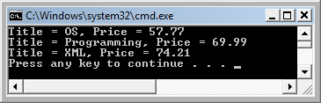
SQL as a Functional Programming Language Using Filter
Define the subset for the query result
var myQuery =
from b in Books
where b.price < 80
orderby b.title
select b;
foreach (Book item in myQuery)
Console.WriteLine("Title = {0}, Price = {1}",
item.title, item.price);
}
}
}
Query written in LINQ constructs
Query written in SQL constructs
Filter
Printing or processing the subset resulted in from the query

Slide 101
Design Your Own Higher Functions
Read text section 4.9.3
For examples:
(deep-filter pred a-list)
e.g., (deep-filter pred ‘(1 3 (4 5) ((6 (7))))
map2 that can perform such function as:
(map2 + '(3 4 5) '(4 5 6) '(5 6 7))
→ (12 15 18)

Slide 102
Equality
How do we decide whether the values of two data structures are equal? For the three basic data types
(= a b) for numbers
(eq? x y) for symbols
(string=? x y) for strings
(char=? x y) for characters
How is about using one for all?
(equal? x y) for any data structures.
(equal? '(1 2) '(1 2 . ())) ⇒ true
(equal? 'Jim "Jim") ⇒ false
(char=? #\5 #\5) ⇒ true

Slide 103
Implementation of equal?
(define equal? (lambda (a b)
(if (and (pair? a) (pair? b)
(and ; Yes
(equal? (car a) (car b))
(equal? (cdr a) (cdr b))
(if (and (number? a) (number? b) ; No
(= a b) ; Yes
(if (and (symbol? a) (symbol? b) ; No
(eq? a b) ; Yes
(if (and (string? a) (string? b)) ; No
(string=? a b) ; Yes
(and (null? a) (null? b)) ; No
))))))

Slide 104
Variadic Procedures
In Scheme, we can define a procedure with an unknown number of parameters
(+ 2 3 6 4 8 14)
(list a b c ...)
(map + '(3 4 5) '(4 5 6) '(5 6 7)) ; → (12 15 18)
In other programming paradigms, the number of parameters needs to be known at compilation time;
An solution in C, C++, Java, C# is:
foo(arg, arg[])
If we have to do this in Scheme, it would be:
(+ 7 ‘(2 3 6 4 8 1 24)), instead of (+ 2 3 6 4 8 14)
(list 4 ‘(a b c d)), instead of (list a b c d)
(map + 3 ‘((3 4 5) (4 5 6) (5 6 7))),
instead of (map + '(3 4 5) '(4 5 6) '(5 6 7))

Slide 105
Programming-in-the-Large
Programming-in-the-small: writing a program module to do a specific task. It is the focus of this course.
Programming-in-the-large: writing a large software system consisting of many modules to handle complex tasks.
Example of an aircraft control system with modules
gather data from aircraft sensors
gather data from air traffic control stations
process data to obtain information on airspeed, nearby aircrafts, and so on
display data to pilot consoles
respond to pilot commands

Slide 106
Programming-in-the-Large
Writing programming-in-the-large, we need to handle
Scopes of names
Modules and their interfaces
Abstract Data Type
Scheme Modules and Interfaces
(module module-name
(export name1 name3 name5 … namen)
(define name1 512)
(define name2 (lambda (x) (…)))
(define name3 …)
…
)
name1 name3 name5, … will be accessible outside the module.
name2 name4, … will not be accessible outside the module.

Slide 107
Programming-in-the-Large: Example
(module encryption
(export string-encryption) ; outside accessible
(define character-rotation (lambda (ch)
(define character-encryption (lambda (ch) (...)))
(define string-encryption (lambda (str) (…)))
(define encryption-recursive (…))
( … )
)
(module secure-email
(define load_file (lambda (str filename) (...)
(string-encryption (load_file (str filetext)))
...
)

Slide 108
Using Modules to Build Large Applications
Organization X:
Component library
Organization Y:
Component library

Slide 109
Service-Oriented Computing (SOC) Paradigm Read Text Chapter 6
Application
proxy
proxy
proxy
proxy
proxy
Auto-searchable
Found
Standard
Interface
Web Service broker
Registration
Organization X:
Component library
Organization Y:
Component library
Organization Z:
Component library

Slide 110
Summary
Introduction
Getting Started with Scheme
Terminology
Some basic scheme procedures
Procedure and macro definition
Scopes: global environment and local names
Theory and Practice of Recursion
Programming with data structure
Higher-order functions: map, reduce, and filter
Programming in the large
Parallel computing concepts
Eager evaluation: (if c a b), evaluate all arguments
Map and Reduce

